Slide 1
Today
Lecture 10: BCS theory --- Temperature dependence, thermodynamics, and coherence factors
Discussion the BCS theory in four parts:
Clues to the mechanism and the Cooper instability problem
Attractive interaction and the BCS wavefunction and ground state
Self-consistent solution and quasiparticles
Temperature dependence, thermodynamics, and coherence factors
Electrodynamics, non-equilibrium superconductivity, and beyond BCS
Next time
Lecture 11: Electrodynamics, non-equilibrium superconductivity, and beyond BCS

Slide 2
Last time
Introduced the Bogoliubov quasiparticle operators:
Diagonalized the “model” BCS Hamiltonian:
Leading to:
ground state
excitations
creates a state with $\overset{⇀}{k}↑$ occupied and
$−\overset{⇀}{k}↓$ empty --- all other states are unchanged from the ground state
creates a state with $−\overset{⇀}{k}↓$ occupied and
$\overset{⇀}{k}↑$
empty --- all other states are unchanged from the ground state

Slide 3
Occupation in ground state
Pairing interaction
Effective charge

Slide 4
Excitation picture
Normal metal
(T=0)
Superconductor
(T=0)
1
GROUND
STATE
1
“electron”
EXCITATIONS
spin
Quasiparticles do not need to be created in pairs because the ground state charge can change
created in pairs to conserve charge
Also
“hole”
holes
electrons
electrons
electron-like qp’s
holes
hole-like qp’s

Slide 5
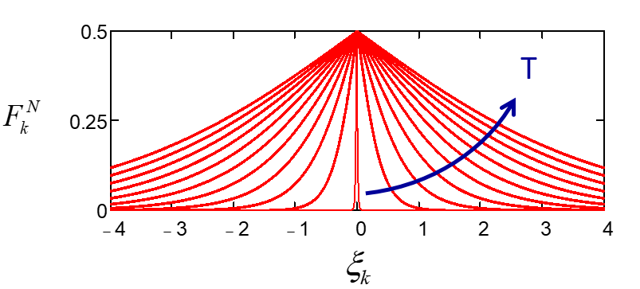
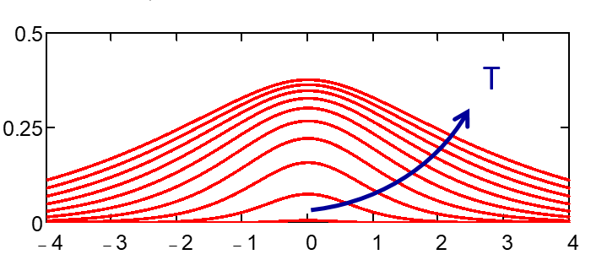
Finite temperature --- thermal activation of excitations
Normal metal
Superconductor
OCCUPATION PROBABLILITY
OCCUPATION PROBABILITY
Thermally-activated carriers due to energy gap
Temperature dependence comes from and

Slide 6
Temperature dependence of the energy gap
$$\text{number} \text{o}\text{pe}\text{rators} \text{for} \text{QP}\text{′}\text{s}$$
$$\text{Gap} \text{equation}\text{:}$$
Using BCS form for the attractive interaction:
Solve to get Δ

Slide 7
Convert to integral ⇒ compute
numerically
1
1
occurs when
Gap equation:
For weak coupling ($N\left(0\right)V≪1)$
$$=0.577$$
$$\text{Euler}\text{′}\text{s} \text{constant}$$

Slide 8
Comparing the electron distribution is the normal and superconducting state
Normal metal
At
Superconductor at T=0
$$f_{N}(ξ,Tc)$$
$$f_{N}(ξ,Tc)\text{ −}$$
$$f_{S}\left(ξ,0\right)$$
$$f_{S}\left(ξ,0\right)$$
In general:
empty pair state
Electron-state occupation does not change much --- the key to superconductivity is the pair correlations induced by the attractive interaction
qp in $\overset{⃑}{k}$
full
pair state
no qp in $−\overset{⃑}{k}$

Slide 9
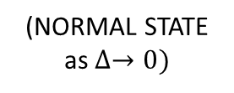
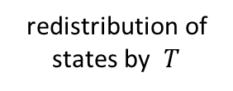
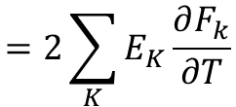
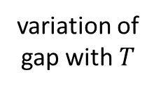
Thermodynamics
Excitations are fermions $\overset{⃑}{k}, Ek$:
$$γT$$
$S_{s}=−2kB$ $\sum_{k}{\left[\left(1−Fk\right) ℓn\left(1−Fk\right)+Fk ℓnFk\right]}$
$S_{N}=−2kB$ $\sum_{k}{\left[\left(1−{Fk}^{N}\right) ℓn\left(1−{Fk}^{N}\right)+{Fk}^{N} ℓn {Fk}^{N}\right]}$
$$S$$
$$S_{N}$$
$S_{S<}$ $S_{N}$(pairing)
$$Fk=\sum_{K}{\frac{1}{e^{{Ek}/{kBT}}+1} }$$
$$F_{k}^{N}=\frac{1}{e^{{\left|ξk\right|}/{kBT}}+1}$$
$$S_{S}$$
$$T$$
$$Tc$$
$$C=T\frac{dS}{dt}$$
$$=−2k_{B}T \sum_{K}{\left(−\frac{∂F_{k}}{∂T}\right)ℓn\left(\frac{F_{k}}{1−F_{k}}\right)}$$
$$=2\sum_{K}{E_{K}\frac{∂F_{k}}{∂T}}$$
$$=\frac{2}{T} \sum_{K}{\left(−\frac{∂F_{k}}{∂Ek}\right)\left[Ek^{2}−\frac{1}{2}T \frac{d\left(Δ^{2}\right)}{dT}\right]}$$
redistribution of states by $T$
variation of gap with $T$
(NORMAL STATE as $∆→0)$
(SC STATE)

Slide 10
$$∆C$$
$$∆$$
$$C_{S}$$
$$C$$
$$∆\left(0\right)$$
$$C_{N}$$
$$T$$
$$Tc$$
$$T$$
$$Tc$$
Low $T \left(T≪Tc\right)$ : $∆\left(T\right)$constant so 2nd term $→0$
$$\left(−\frac{∂F_{k}}{∂Ek}\right)\sim e^{{−∆}/{kBT}}$$
exponential behavior
Near $Tc, Δ\left(T\right) \sim 1.74 ∆(0){\left(1−\frac{T}{Tc}\right)}^{1/2}$
$$=1.74 \left(1.76 k_{B}Tc\right){\left(1−\frac{T}{Tc}\right)}^{1/2}$$
High $T \left(T\sim Tc\right)$ : $∆\left(T\right)→0$ so 1st term = normal state
$$=3.07 k_{B}Tc{\left(1−\frac{T}{Tc}\right)}^{1/2}$$
$\frac{d}{dT}\left(∆^{2}\right)$finite so jump at $T=Tc$
$$∆C=\left[\sum_{K}{\left(−\frac{∂F_{k}}{∂Ek}\right)}\right]\frac{d}{dT}\left(∆^{2}\right)$$
$$ΔC=9.42 N\left(0\right){k_{B}}^{2}Tc$$
$(at Tc$)
$C_{N}= \frac{2π^{2}}{3}$ $N\left(0\right){k_{B}}^{2}Tc$
$=6.58$ $N\left(0\right){k_{B}}^{2}Tc$
$$=N\left(0\right)\frac{d}{dT}\left(∆^{2}\right)$$
$(at Tc$)
$$\frac{ΔC}{C_{N}}=1.43$$

Slide 11
Coherence Factors
Quasiparticles can scatter, be created (pairbreaking), or be destroyed (recombination)
The processes are different from these in normal metals because of:
different density of states
energy gap
Interference terms $⇒$coherence factors
$$\overset{⃑}{k}′σ′$$
$$H_{1}=\sum_{{kk′ \atop σσ′}}{\left(M_{{kk′ \atop σσ′}}\right)ck′σ′{+c}_{kσ}}$$
Consider a perturbation to system:
$$\overset{⃑}{k}σ$$
something - on
NORMAL STATE $c$’s are qp operators $⇒ {\left|M\right|}^{2}$ matrix elements
$γ$’s are qp operators which involve correlations between $\vec{k}, −\vec{k}$ states $⇒ {\left|M\right|}^{2}$ modified
SC STATE
e.g.
$$−\overset{⃑}{k}↓$$
$$\overset{⃑}{k}′↑$$
$$\left({{c_{−k↑}}^{+}}^{ }=u_{k}^{′} {γ_{k0}}^{+}+ v_{k}^{′} γ_{k^{′}1}\right)×\left(c_{k↑}=uk γ_{k0}+v_{k} {γ_{k1}}^{+}\right)$$
$$−\overset{⃑}{k}′↓$$
$$\overset{⃑}{k}↑$$
$$\left({c_{−k↑}}^{+}=u_{k} {γ_{k1}}^{+}− v_{k}γ_{k^{′}0}\right)×\left(c_{−k↓}=uk γ_{k^{′}1}−v_{k1} {γ_{k^{′}0}}^{+}\right)$$

Slide 12
qp scattering
qp creation
qp recombination
$${c^{+}}_{k^{′}↑} c_{k↑}$$
$$u_{k}u_{k^{′}}$$
$$−v_{k}v_{k^{′}}$$
$$u_{k^{′}}v_{k}$$
$$u_{k}v_{k^{′}}$$
$${c^{+}}_{−k↓} c_{−k^{′}↓}$$
$$−v_{k}v_{k^{′}}$$
$$u_{k}u_{k^{′}}$$
$$u_{k}v_{k^{′}}$$
$$u_{k^{′}}v_{k}$$
If we write $H_{1}$ in terms of qp operators $γ$, must add before squaring to get matrix elements:
$$H_{1}=Σ ℳ\left(γγ\right) γγ$$
Two cases:
I. Scalar field $M_{k^{′}k}=M_{−k−k^{′}}$(EVEN)
e.g. electron-phonon interaction, ultrasonic attenuation
depends on $\left|Δk\right|$ only
II. Vector field $M_{k^{′}k}=−M_{−kk^{′}}$ (ODD)
e.g. electromagnetic fields $\overset{⃑}{k}∙\overset{⃑}{A}$
depends on $\overset{⃑}{(k}−\overset{⃑}{k′}$) only

Slide 13
Matrix elements :
(not transition probability which also depends on $F_{k}\left(1−F_{k′}\right)$)
SCATTERING
Integrated over ξ
For E,E’~Δ
For E,E’ Δ
CASE I
${(u}_{k}u_{k^{′}}−v_{k}v_{k′}$)² = $\frac{1}{2}\left(1+\frac{ξξ′}{EE′}−\frac{Δ^{2}}{EE′}\right) =\frac{1}{2}\left(1−\frac{Δ^{2}}{EE′}\right)$
$$0$$
$$\frac{1}{2}$$
CASE II
($u_{k}u_{k′}+v_{k}v_{k′}$)² = $\frac{1}{2}\left(1+\frac{ξξ′}{EE′}+\frac{Δ^{2}}{EE′}\right) =\frac{1}{2}\left(1+\frac{Δ^{2}}{EE′}\right)$
$$\frac{1}{2}$$
$$1$$
CREATION/ANNIHILATION
CASE I
$\left(u_{k^{′}}v_{k}+u_{k}v_{k^{′}}\right)2$ = $\frac{1}{2}\left(1−\frac{ξξ^{′}}{EE^{′}}+\frac{Δ^{2}}{EE′}\right) =\frac{1}{2}\left(1+\frac{Δ^{2}}{EE′}\right)$
1
$$\frac{1}{2}$$
CASE II
${(u}_{k′}v_{k}−u_{k}v_{k^{′}})2$ = $\frac{ 1}{2}\left(1−\frac{ξξ′}{EE′}−\frac{Δ^{2}}{EE′}\right) =\frac{1}{2}\left(1−\frac{Δ^{2}}{EE′}\right)$
$$0$$
$$\frac{1}{2}$$
large difference between cases
small difference

Slide 14
Examples
Type I Ultrasonic attenuation
Type II Nuclear relaxation
$$\left(\text{s}\text{pin}\text{−}\text{qp} \text{interaction}\text{, }\text{electromagnetic} \text{ab}\text{s}\text{or}\text{p}\text{tion} \right)$$
diverges
broadening (finite lifetimes qp’s, unparticles
$$1$$
$$N$$
#qp’s $\sim {\left(\frac{T}{Tc}\right)}^{4}$
Hebel-Slichter peak
$$\frac{α_{S}}{α_{N}}$$
$$II$$
$$2Fk\left(0\right)=\frac{2}{{1+e}^{∆/{kBT}}}$$
$$I$$
$$Tc$$
$$T$$
Great success – impossible to explain by two-fluid model or energy gap model$⇒$coherence vital
$$Γ_{kk′}\sim {\left|M\right|}^{2} {\left|C\right|}^{2} F_{k}\left(1−F_{k′}\right)$$
rate
$${\left|ℳ\right|}^{2}$$
occupation
probability

Slide 15
Coherence Factors
Physical picture:
NORMAL
SUPERCONDUCTING
Electron correlations cause interference between qp transition probabilities $⇒$selection rule for transitions depending on symmetry of perturbation
$$\overset{⃑}{k}$$
$${c^{+}}_{k′}c_{k}$$
$$\overset{⃑}{k}$$
$$−\overset{⃑}{k}′$$
$$\overset{⃑}{k}$$
$$\overset{⃑}{k}′$$
$$−\overset{⃑}{k}$$
$$Γ_{KK′}\sim {\left|M\right|}^{2} {\left|C\right|}^{2} F_{K}\left(1−F_{K′}\right)$$
$I$destructive interference
e.g. rapid decay with temperature in ultrasonic attenuation
example:
$$II$$
$$ℳ^{2}$$
$II$constructive interference
e.g. Hebel-Slichter peak in NMR
# qp’s
$$I$$

